Slide 1



STUDENT MANAGEMENT SOFTWARE

Slide 2
CORE OBJECTIVES
Presentation: Explain abstract data types and their benefits in software development.
Application: Create a student management program using algorithms.
Algorithm Evaluation: Propose and evaluate alternative algorithms.

Slide 3
KEY REQUIREMENTS
Abstract Data Types (ADTs): Define and explain their role in design, development, and testing.
Algorithms: Present algorithms in formal notation and their application in the student management program.
Student Management: Implement features for adding, editing, deleting, sorting, and searching students.
Ranking: Calculate student rankings based on a given scoring system.
Algorithm Evaluation: Compare the effectiveness of different algorithms for the task.

Slide 4
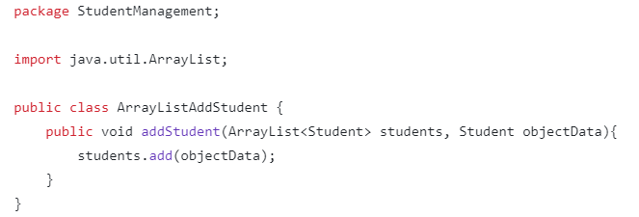
ADD STUDENT FUNCTION
package StudentManagement;
This line declares that the class belongs to the StudentManagement package. Packages are used to organize classes and prevent naming conflicts.
import java.util.ArrayList;
This line imports the ArrayList class from the java.util package. ArrayList is a dynamic array that can grow or shrink as needed. This import makes it so you don't have to use the full java.util.ArrayList every time you refer to it.

Slide 5
public class ArrayListAddStudent { ... }
This line declares a public class named ArrayListAddStudent. The public keyword means this class is accessible from other classes, even those in different packages. The code within the curly braces {} defines the class's members.
public void addStudent(ArrayList<Student> students, Student objectData) { ... }
This declares a public method named addStudent. Let's analyze its parts:
public: The method is accessible from other classes.
void: The method doesn't return any value.
ArrayList<Student> students: This is the first parameter. It's an ArrayList that holds objects of the Student class (presumably a custom class defining student attributes). This parameter represents the list of students to which we'll add a new student.
Student objectData: This is the second parameter. It represents the Student object to be added to the list.
students.add(objectData);
This line is inside the addStudent method. It uses the add() method of the ArrayList to append the objectData (the new student) to the end of the students list.

Slide 6
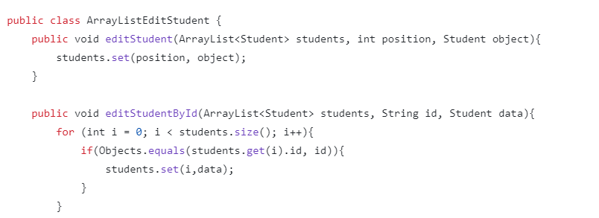
Student edit function
Class declaration:
public class ArrayListEditStudent: Declare a public class named ArrayListEditStudent. This class will contain methods to perform modifications to the student list.

Slide 7
editStudent method:
public void editStudent: This is a public method that does not return a value (void).
ArrayList<Student> students: The first parameter is an ArrayList containing Student objects. This is the list of students that we want to modify.
int position: The second parameter is the position in the list that we want to change.
Student object: The last parameter is the new Student object that we want to assign to the given position.
students.set(position, object): This line replaces the object at position in the students list with the new object.

Slide 8

EditStudentById method:
public void editStudentById: Similar to the editStudent method, this is also a public method that does not return a value.
ArrayList<Student> students: Also an ArrayList containing Student objects.
String id: This parameter is a string representing the ID of the student we want to find and modify.
Student data: The new Student object that we want to assign to the student with the matching ID.
for (int i = 0; i < students.size(); i++): This loop iterates through each element in the students list.
if (Objects.equals(students.get(i).id, id)): Checks if the current student ID is equal to the required ID. If so, then modify.
students.set(i, data): Replaces the current student object with the new data object.

Slide 9
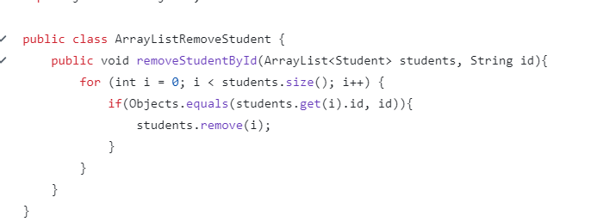
Delete student function
Class declaration:
public class ArrayListRemoveStudent: Similar to the previous code, we declare a public class named ArrayListRemoveStudent. This class will contain the method to delete the student.

Slide 10

removeStudentById method:
public void removeStudentById: This is a public method that does not return a value.
ArrayList<Student> students: This parameter is a list of Student objects that we want to delete.
String id: This parameter is the ID of the student that we want to delete.

Slide 11
Loops and conditions:
for (int i = 0; i < students.size(); i++): This loop iterates through each element in the students list.
if (Objects.equals(students.get(i).id, id)): Checks if the current student ID is equal to the required ID. If so, deletes it.
students.remove(i): Deletes the element at position i in the list.

Slide 12
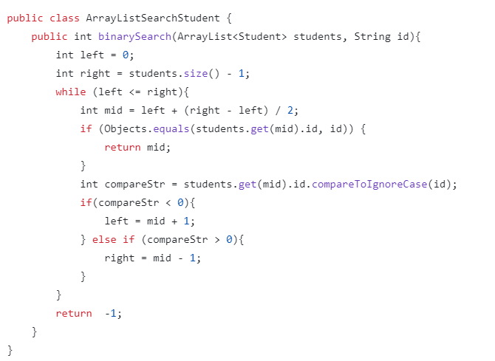
Student search function

Slide 13

Class declaration:
Declare a public class named ArrayListSearchStudent to contain methods related to searching for students.
binarySearch method:
This method takes two parameters:
students: A list of Student objects sorted by ID.
id: The ID of the student to find.
The method returns the index of the student found in the list, or -1 if not found.
Initialize variables:
left: Index of the first element in the search range.
right: Index of the last element in the search range.

Slide 14

While loop:
This loop will continue until the remaining search range is empty (left > right).
Calculate the average value:
Calculates the index of the element in the middle of the current search range.
Compare and return results:
If the student ID in the middle position is equal to the ID to be found, return that index.

Slide 15
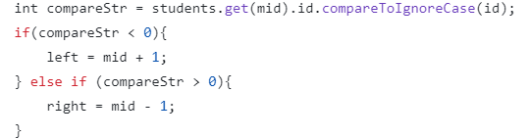
Adjust search range:
Compare the ID of the middle student with the ID you want to find.
If the ID of the middle student is smaller than the ID you want to find, narrow the search range to the right half of the list.
If the ID of the middle student is larger than the ID you want to find, narrow the search range to the left half of the list.
If not found:
If the loop ends without finding any students, return -1.

Slide 16
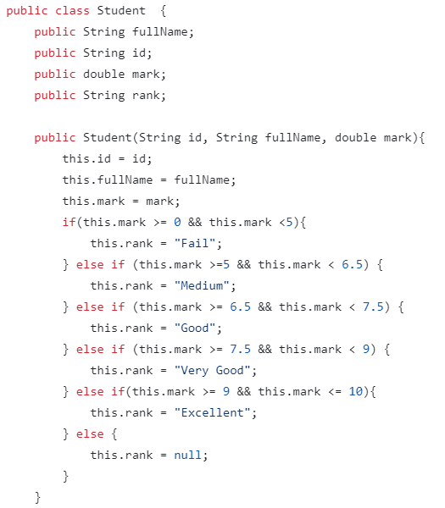
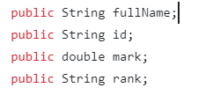
Class Student :
Class declaration:
This line declares a public class named Student. A public class means that the class can be accessed from anywhere in the program.
Property declaration:
The Student class has four properties:
fullName: String containing the full name of the student.
id: String containing the student's ID number.
mark: Double containing the student's score.
rank: String containing the student's ranking based on the score.

Slide 17

Constructor:
This constructor is called when a new object of the Student class is created. It takes three parameters: student ID, full name, and score. These parameters are assigned to the corresponding properties of the object.
Classification:
The code inside the constructor performs the calculation and assigning of grades to students based on their scores. The logic for calculating grades is implemented through if-else statements.

Slide 18
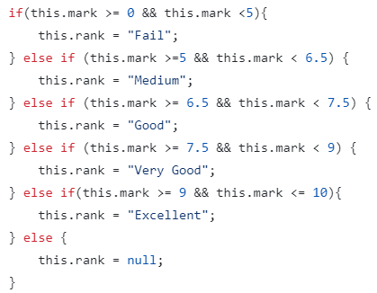
Explain the logic of the ranking:
Condition: Each condition checks whether the score falls within a certain rating range.
Assigning a value: If the condition is true, the corresponding rating is assigned to the rank attribute.
Handling special cases: If the score does not fall within any of the specified ranges, the rating is assigned null.

Slide 19
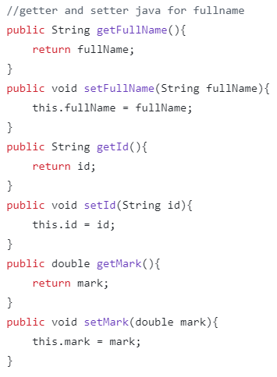
The code in the image is a simple implementation of Java getter and setter methods for the fields fullName, id, and mark. Here's an explanation of each part:
getFullName() and setFullName():
These methods manage access to and modification of the fullName attribute.
getFullName() returns the current value of fullName.
setFullName(String fullName) assigns a new value to fullName.
getId() and setId():
These methods are for handling the id field.
getId() returns the current value of the id attribute.
setId(String id) allows updating the value of id.
getMark() and setMark():
These methods control access to and modification of the mark attribute.
getMark() returns the current value of mark, which is a double.
setMark(double mark) sets a new value to the mark attribute.

Slide 20
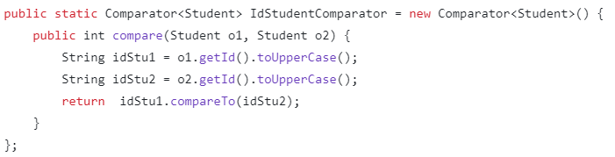
This code defines a comparator for comparing two Student objects based on their id values. Here’s an explanation of each part:
public static Comparator<Student> IdStudentComparator:
This creates a static comparator object that can be used to compare Student objects. It is declared as Comparator<Student>, meaning it works specifically for Student objects.
new Comparator<Student>() { ... }:
This creates an anonymous class that implements the Comparator<Student> interface, defining the logic for comparing two Student objects.

Slide 21
compare(Student o1, Student o2):
This method implements the comparison logic.
It takes two Student objects (o1 and o2) as parameters and compares them based on their id fields.
o1.getId().toUpperCase() and o2.getId().toUpperCase():
These lines retrieve the id of each student and convert it to uppercase to ensure case-insensitive comparison.
idStu1.compareTo(idStu2):
This compares the two id strings (idStu1 and idStu2).
The compareTo method returns:
A negative value if idStu1 is lexicographically smaller than idStu2.
0 if they are equal.
A positive value if idStu1 is larger than idStu2.

Slide 22
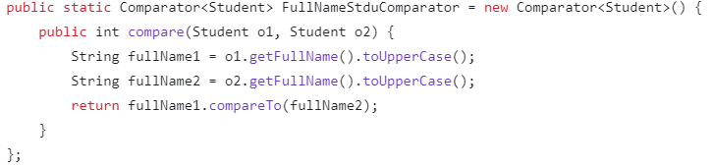
The code shown defines a comparator for comparing two Student objects based on their fullName values. Here's an explanation of each part:
public static Comparator<Student> FullNameStdComparator:
This defines a static comparator for comparing Student objects based on their fullName. It is of type Comparator<Student>, which means it works specifically for comparing Student objects.
new Comparator<Student>() { ... }:
This is an anonymous class that implements the Comparator<Student> interface. It provides the logic required to compare two Student objects based on their full names.

Slide 23
compare(Student o1, Student o2):
This method contains the logic to compare two Student objects. It takes two Student objects, o1 and o2, as input parameters and compares their fullName fields.
o1.getFullName().toUpperCase() and o2.getFullName().toUpperCase():
These lines retrieve the fullName of each Student object and convert them to uppercase. This ensures that the comparison is case-insensitive (so "John" and "john" are treated as equal).
fullName1.compareTo(fullName2):
This compares the two fullName strings (fullName1 and fullName2).
The compareTo method returns:
A negative value if fullName1 is lexicographically smaller than fullName2.
0 if they are equal.
A positive value if fullName1 is larger than fullName2.

Slide 24
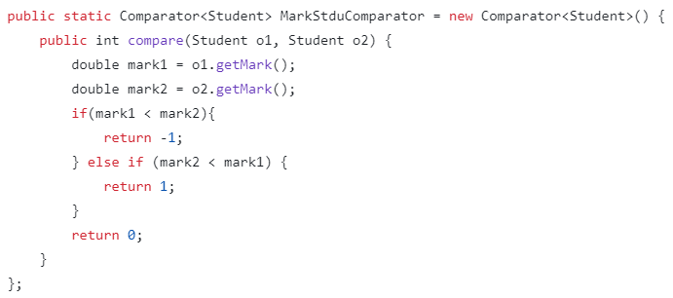
This code defines a class called ComparatorStudent with a static method compare(Student o1, Student o2). The purpose of this method is to compare two Student objects based on their marks.
Here's a breakdown of the code:
public static Comparator<Student> MarkStduComparator = new Comparator<Student>() { ... }:
This line creates a new Comparator<Student> object and assigns it to the MarkStduComparator static field. The Comparator interface is used to define a custom comparison logic for objects.
public int compare(Student o1, Student o2) { ... }:
This is the implementation of the compare(Student o1, Student o2) method, which is part of the Comparator interface. This method takes two Student objects as input and returns an integer value that represents the comparison result.

Slide 25
double mark1 = o1.getMark(); and double mark2 = o2.getMark();:
These lines retrieve the marks of the two Student objects and store them in the mark1 and mark2 variables, respectively.
if (mark1 < mark2) { return -1; } else if (mark2 < mark1) { return 1; }:
This part of the code compares the marks of the two Student objects. If the mark of o1 is less than the mark of o2, it returns -1, indicating that o1 is less than o2. If the mark of o2 is less than the mark of o1, it returns 1, indicating that o1 is greater than o2.
return 0;: If the marks of the two Student objects are equal, the method returns 0, indicating that they are equal.

Slide 26
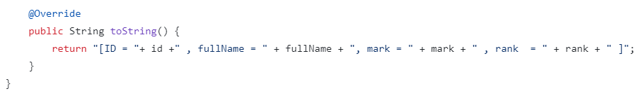
The provided code defines a public method named toString() within a class called @Override. The purpose of this method is to return a string representation of an object in a specific format.
Here's a breakdown of the code:
public String toString() {:
This line declares the toString() method, which is a standard method in Java that is used to provide a string representation of an object.
return "[ID = " + id + " , fullName = " + fullName + ", mark = " + mark + ", rank = " + rank + "]";:
This line constructs and returns a string that includes the values of several properties of the object, such as id, fullName, mark, and rank. The string is formatted to include labels for each of these properties, enclosed within square brackets.

Slide 27
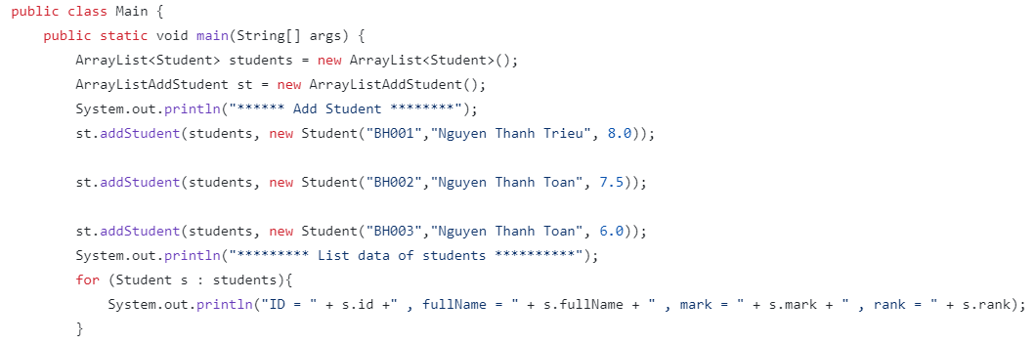
MAIN
The purpose of this code is to create and manipulate a list of Student objects.
Here's a breakdown of the code:
public class Main {: This line declares the Main class.
public static void main(String[] args) {: This line defines the main() method, which is the entry point of the program.
ArrayList<Student> students = new ArrayList<>();: This line creates a new ArrayList of Student objects and assigns it to the students variable.

Slide 28

ArrayListAddStudent st = new ArrayListAddStudent();: This line creates a new ArrayListAddStudent object and assigns it to the st variable. This object likely has methods to add new Student objects to the students list.
st.addStudent(students, new Student("BH001", "Nguyen Thanh Trieu", 8.0));: This line calls the addStudent() method of the st object, passing the students list and a new Student object as arguments. This adds a new student with the ID "BH001", name "Nguyen Thanh Trieu", and mark 8.0 to the students list.

Slide 29
st.addStudent(students, new Student("BH002", "Nguyen Thanh Toan", 7.5));: This line adds another student with the ID "BH002", name "Nguyen Thanh Toan", and mark 7.5 to the students list.
st.addStudent(students, new Student("BH003", "Nguyen Thanh Toan", 6.0));: This line adds a third student with the ID "BH003", name "Nguyen Thanh Toan", and mark 6.0 to the students list.
System.out.println("********* List data of students *********");: This line prints a message to the console.
for (Student s : students) { ... }: This is a "for-each" loop that iterates over the students list and prints the ID, fullName, mark, and rank of each student.

Slide 30
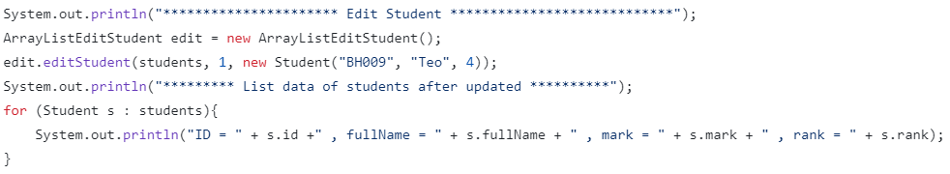
System.out.println("******************** Edit Student ********************");: This line prints a message to the console indicating that the student list is about to be edited.
ArrayListEditStudent edit = new ArrayListEditStudent();: This line creates a new ArrayListEditStudent object and assigns it to the edit variable. This object likely has methods to edit the Student objects in the students list.
edit.editStudent(students, 1, new Student("BH009", "Teo", 4.0));: This line calls the editStudent() method of the edit object. It takes three arguments:
students: the list of Student objects to be edited
1: the index of the student to be edited (in this case, the second student in the list)
new Student("BH009", "Teo", 4.0): a new Student object with the updated information (ID "BH009", name "Teo", and mark 4.0)
This line effectively updates the second student in the students list with the new information.

Slide 31
System.out.println("********* List data of students after updated *********");: This line prints a message to the console indicating that the list of students has been updated.
for (Student s : students) { ... }: This is the same "for-each" loop as in the previous code, which iterates over the students list and prints the ID, fullName, mark, and rank of each student.

Slide 32
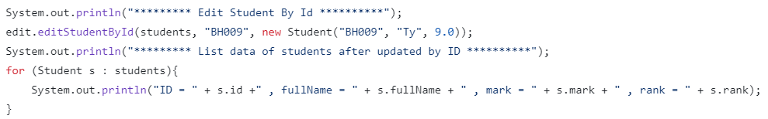
System.out.println("********* Edit Student By Id *********");: This line prints a message to the console indicating that a student will be edited by their ID.
edit.editStudentById(students, "BH009", new Student("BH009", "Ty", 9.0));: This line calls the editStudentById() method of the edit object. It takes three arguments:
students: the list of Student objects to be edited
"BH009": the ID of the student to be edited
new Student("BH009", "Ty", 9.0): a new Student object with the updated information (ID "BH009", name "Ty", and mark 9.0)
This line effectively updates the student in the students list with the ID "BH009" with the new information.

Slide 33

System.out.println("********* List data of students after updated by ID *********");: This line prints a message to the console indicating that the list of students has been updated.
for (Student s : students) { ... }: This is the same "for-each" loop as in the previous code, which iterates over the students list and prints the ID, fullName, mark, and rank of each student.

Slide 34
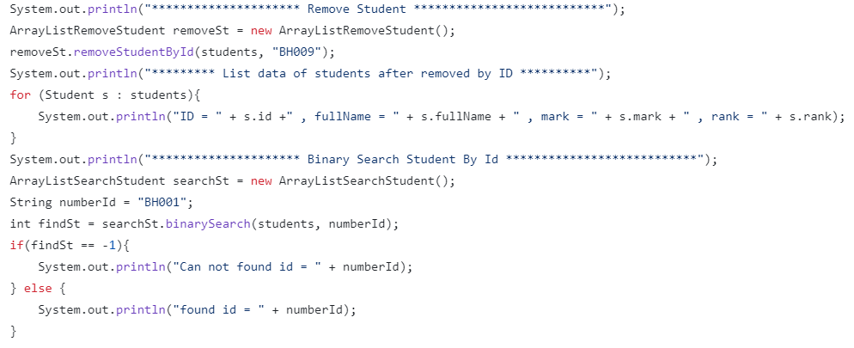
Removing a Student by ID:
System.out.println("******************** Remove Student ********************");: This line prints a message to the console indicating that a student will be removed.
ArrayListRemoveStudent removeSt = new ArrayListRemoveStudent();: This line creates a new ArrayListRemoveStudent object and assigns it to the removeSt variable. This object likely has methods to remove Student objects from the students list.
removeSt.removeStudentById(students, "BH009");: This line calls the removeStudentById() method of the removeSt object. It takes two arguments:
students: the list of Student objects to be modified
"BH009": the ID of the student to be removed
This line effectively removes the student with the ID "BH009" from the students list.

Slide 35

System.out.println("********* List data of students after removed by ID *********");: This line prints a message to the console indicating that the list of students has been updated after the removal.
for (Student s : students) { ... }: This is the same "for-each" loop as in the previous code, which iterates over the students list and prints the ID, fullName, mark, and rank of each student.

Slide 36
Binary Search for a Student by ID:
System.out.println("******************** Binary Search Student By Id ********************");: This line prints a message to the console indicating that a student will be searched for by their ID using binary search.
ArrayListSearchStudent searchSt = new ArrayListSearchStudent();: This line creates a new ArrayListSearchStudent object and assigns it to the searchSt variable. This object likely has methods to perform binary search on the students list.
String numberId = "BH001";: This line assigns the string value "BH001" to the numberId variable, which represents the ID of the student to be searched for.

Slide 37
int findSt = searchSt.binarySearch(students, numberId);: This line calls the binarySearch() method of the searchSt object. It takes two arguments:
students: the list of Student objects to be searched
numberId: the ID of the student to be searched for
The method returns the index of the student with the matching ID, or -1 if the student is not found.
if (findSt == -1) { ... } else { ... }: This is an if-else statement that checks the value of findSt. If it's -1, it means the student was not found, and the code prints a message indicating that. If the value is not -1, it means the student was found, and the code prints a message indicating the found ID.

Slide 38
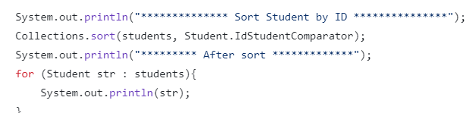
This code snippet demonstrates how to sort a list of Student objects by their ID using the Collections.sort() method.
Here's a breakdown of the code:
System.out.println("*************** Sort Student by ID ***************");: This line prints a message to the console indicating that the students will be sorted by their ID.
Collections.sort(students, Student.IdStudentComparator);: This line calls the sort() method of the Collections class. It takes two arguments:
students: the list of Student objects to be sorted
Student.IdStudentComparator: a static Comparator object defined in the Student class, which is used to compare Student objects based on their ID.
This line sorts the students list in ascending order based on the student ID.
System.out.println("********* After sort ***********");: This line prints a message to the console indicating that the sorting process is complete.
for (Student str : students) { ... }: This "for-each" loop iterates over the sorted students list and prints the details of each student.

Slide 39
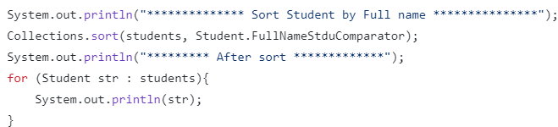
This code snippet demonstrates how to sort a list of Student objects by their full name using the Collections.sort() method.
Here's a breakdown of the code:
System.out.println("*************** Sort Student by Full name ***************");: This line prints a message to the console indicating that the students will be sorted by their full name.
Collections.sort(students, Student.FullNameStduComparator);: This line calls the sort() method of the Collections class. It takes two arguments:
students: the list of Student objects to be sorted
Student.FullNameStduComparator: a static Comparator object defined in the Student class, which is used to compare Student objects based on their full name.
This line sorts the students list in ascending order based on the student's full name.
System.out.println("********* After sort ***********");: This line prints a message to the console indicating that the sorting process is complete.
for (Student str : students) { ... }: This "for-each" loop iterates over the sorted students list and prints the details of each student.

Slide 40
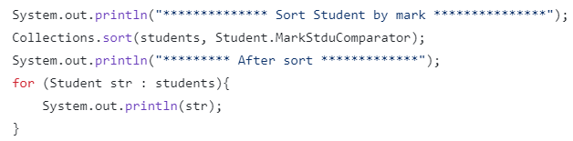
This code snippet demonstrates how to sort a list of Student objects by their marks using the Collections.sort() method.
Here's a breakdown of the code:
System.out.println("*************** Sort Student by mark ***************");: This line prints a message to the console indicating that the students will be sorted by their marks.
Collections.sort(students, Student.MarkStduComparator);: This line calls the sort() method of the Collections class. It takes two arguments:
students: the list of Student objects to be sorted
Student.MarkStduComparator: a static Comparator object defined in the Student class, which is used to compare Student objects based on their marks.
This line sorts the students list in ascending order based on the student's marks.
System.out.println("********* After sort ***********");: This line prints a message to the console indicating that the sorting process is complete.
for (Student str : students) { ... }: This "for-each" loop iterates over the sorted students list and prints the details of each student.

